Slide 1
Continuous Water-Quality Monitoring
Notes:
When care is taken to collect good data continuous water-quality monitoring can provide many useful insights into physical, biological, and chemical processes taking place in the water resource of interest.

Slide 2
Continuous Water Quality Monitoring
Advantages
Disadvantages
Needed in rapidly changing systems
Provides better understanding of interaction between constituents
Provides better understanding of transport processes
Equipment costs are greater
Operation and maintenance costs are greater
Vulnerable to damage and/or loss

Slide 3
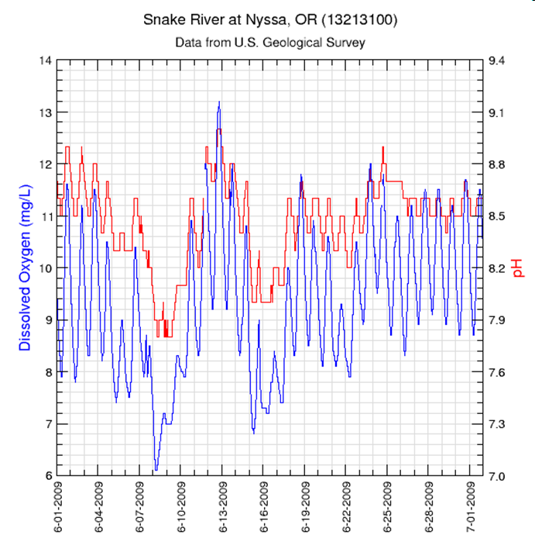
Relations Between Parameters DO and pH
DO and pH track together
Diurnal Pattern
Why?
Notes:
DO goes up during the day when biological productivity is high DO drops off at night when aquatic organisms are using DO and respiring CO2
CO2 combines with H20 to form H2CO3 or carbonic acid The increased carbonic acid causes pH to go down at night.
Thus there is a direct relation between DO and pH with a strong diurnal cycle
Collecting continuous QW data allows you to better observe these types of relations which leads to a better understanding of physical processes and the interacton of constituents

Slide 4
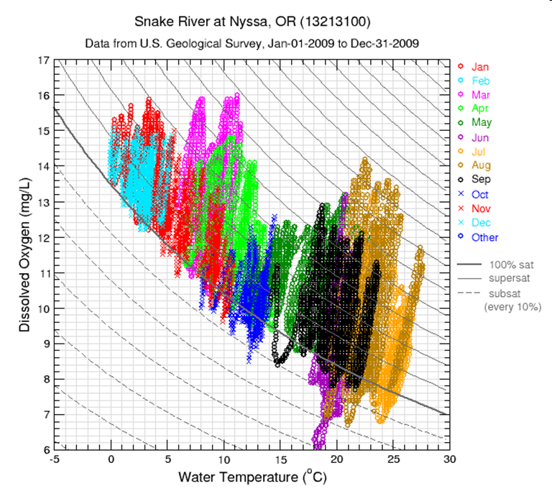
Relations Between Parameters DO and Temperature
Super-saturated DO
DO crash in June
Variation in DO changes seasonally
Notes:
Saturated means the amount of DO under equilibrium conditions but supersaturation occurs as a result of aquatic growth and mechanical entrainment. The DO concentration for saturation is reduced as the water temperature rises which produces the monthly and seasonal variations.
Daily variations are controlled by photosynthesis and respiration. During the day when photosynthesis is at its peak you have maximum DO.
At night photosynthesis shuts down and organisms begin respiring and producing CO2.
DO drop in June is likely due to an algae bloom producing lots of oxygen in the day followed by a drop off in DO production at night but with the respiration process of the algae dominating and taking up the available DO during the night
If you go out at 10 everyday you’re going to get 120% and think everything’s great and you’re not aware of the DO sag at night that stress the fish.
In winter less aquatic growth so less DO production and swings

Slide 5
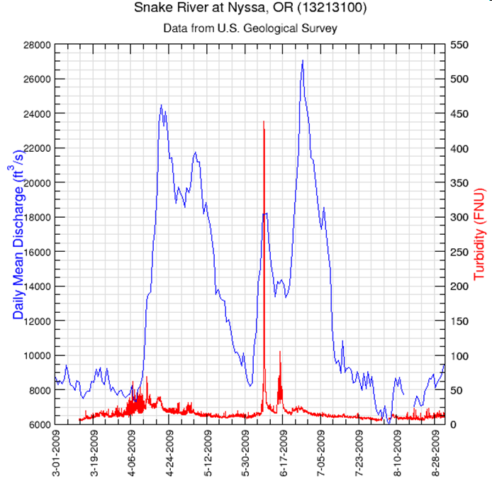
Relations Between Parameters Turbidity –vs- Discharge
Notes:
This slide shows the relation between turbidity and streamflow.
Turbidity is a good surrogate for suspended sediment or TSS
In a natural stream you often see a first flush of sediment during the high flows that occur after a long period of low flow. (snowmelt in ID)
After this flush the sediment concentrations are often lower even during a higher flow event.

Slide 6
Discrete vs Continuous Monitoring
Notes:
In this slide we have 4 types of data shown
Streamflow (cfs)
Suspended sediment concentration (mg/l) from discrete samples
LOADEST model results which are estimates of the sediment load based on streamflow and discrete samples
Continuous suspended sediment concentrations from an Acoustic Backscatter signal (similar to turbidity)
This illustrates the disadvantage of using only a few discrete samples, even when coupled with flow, to estimate instantaneous or even daily loads.

Slide 7
Other Surrogate Possibilities
Continuous Parameter(s) | Surrogate Constituent
Specific Conductance | TDS, Total Nitrogen
Turbidity | Suspended Sediment, Total Phosphorous
Turbidity + Temperature | Bacteria
Relations are developed using discrete samples and linear regression
Regression model used to synthesize continuous record of target parameters that are difficult to monitor.
Parameter -vs- surrogate relations are not universal but site specific

Slide 8
Applications
Continuous monitoring the constituent or its surrogate to aid in identifying occurrence and duration of water-quality parameters that exceed regulatory limits.

Slide 9
Relation between SC and TN

Slide 10
Applications (cont)
Identify and optimize periods for sample collection
Quantify constituent loads (volume/time)
Familiarity with the site and data will lead to a better understanding of physical processes and interactions between constituents

Slide 11
QUESTIONS?

